Slide 1

DEPARTMENT OF
ARTIFICIAL INTELLIGENCE AND DATA SCIENCE
ACADEMIC YEAR 2025 - 2026
SEMESTER III
ARTIFICIAL INTELLIGENCE LABORATORY
MINI PROJECT REVIEW
TRAFFIC ACCIDENT RISK PREDICTION
REGISTER NUMBER | 2117240070137
NAME | KAMALESHWARAN P
YEAR | II
SECTION | C
FACULTY IN-CHARGE | Ms . Phebe Persis

Slide 2
PROBLEM STATEMENT
Brief Overview of Artificial Intelligence Concepts
Artificial Intelligence (AI) is a branch of computer science that enables machines to simulate human intelligence such as reasoning, learning, and decision-making. One of the core applications of AI is probabilistic reasoning, where systems make predictions and decisions even under uncertainty. This is achieved using techniques such as Bayesian inference, Naïve Bayes models, and Bayesian networks, which help in understanding the likelihood of events based on observed data.
Why the Problem Matters
  Accurate prediction of traffic accident risks can help:
  Reduce road accidents through preventive measures.
  Assist city planners in identifying accident-prone zones.
  Improve public safety by alerting drivers of potential risks.
  Help insurance companies and transport departments assess risk levels.
Project Aim
The main goal of this project is to develop a probabilistic reasoning model using Bayesian networks to predict the likelihood of a traffic accident based on parameters such as Time of day, Weather conditions, Road type, Driver condition, Traffic density

Slide 3
THEORETICAL BACKGROUND
Theoretical Background of the Problem and Algorithm
  Probabilistic reasoning provides a mathematical framework to model uncertainty in AI.
  In this project, a Bayesian Network (BN) — a type of probabilistic graphical model — is used to represent causal relationships between different factors that contribute to accidents.
  Each node in the network represents a variable (e.g., weather, road condition), and edges represent dependencies between them.
  The BN computes the probability of an accident based on the joint probabilities of all influencing variables using Bayes’ theorem.
Literature Survey
  Researchers have used Naïve Bayes classifiers for driver behavior analysis and accident prediction due to their simplicity and good performance with limited data.
  Studies show that Bayesian networks outperform deterministic models in handling uncertainty and interdependent variables.
  Hybrid models, combining Bayesian inference with real-time sensor data, have improved prediction accuracy in urban traffic management.
  Machine learning-based risk analysis has been explored in transportation engineering to identify accident hotspots.
Justification for Choosing the Algorithm
  Bayesian networks are chosen because:
  They handle uncertain and incomplete information effectively.
  They provide a causal interpretation of variables influencing accidents.
  They can update predictions dynamically as new data becomes available.
  They support both exact and approximate inference, making them scalable for real-world data.

Slide 4
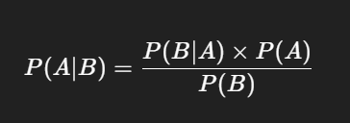
EXPLANATION OF ALGORITHM
Bayes’ Theorem:
Where:
  P(A∣B): Probability of event A (accident) given evidence B (e.g., bad weather).
  P(B∣A): Probability of observing evidence B given accident occurred.
  P(A): Prior probability of accident.
  P(B): Probability of observing evidence B.

Slide 5
IMPLEMENTATION AND CODE
Link to code in Git-hub Repository
List | Git-hub Repository Links
Implementation of Code Link | https://github.com/kamaleshwaran2605/AI-Mini-project.git
Word Document Report Link | https://github.com/kamaleshwaran2605/AI-Mini-project.git
PPT Link | https://github.com/kamaleshwaran2605/AI-Mini-project.git

Slide 6
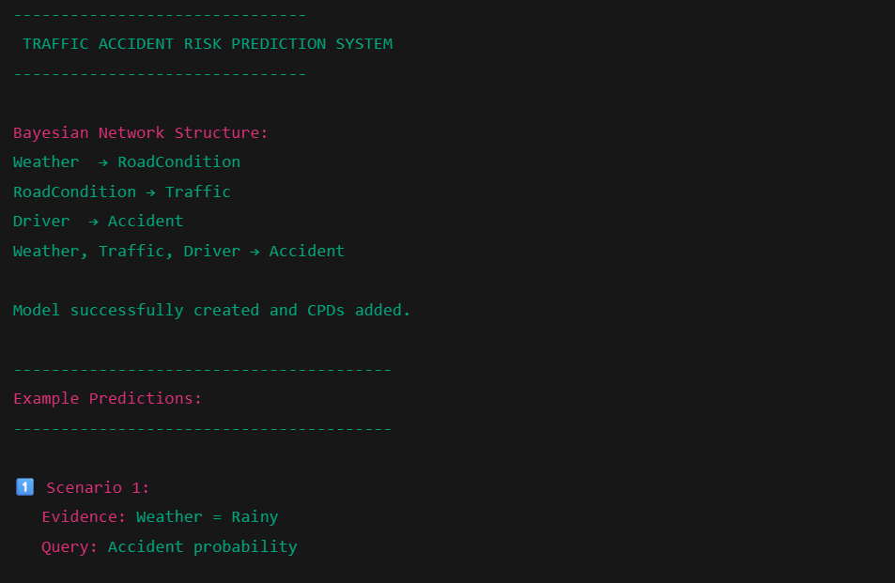
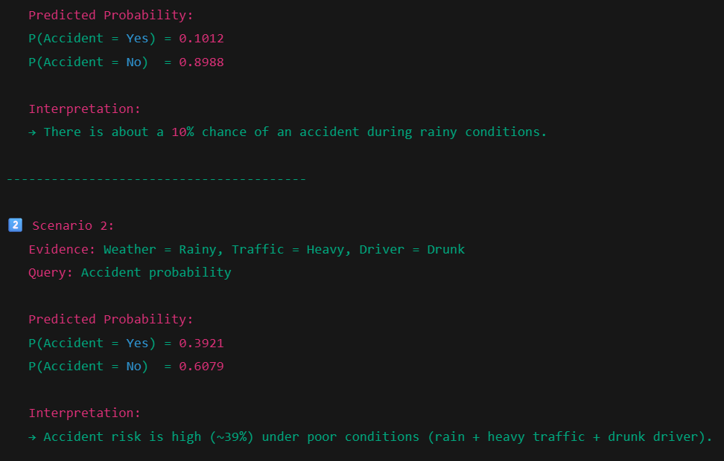
OUTPUT AND RESULTS

Slide 7
REFERENCES
Russell, S., & Norvig, P. (2021). Artificial Intelligence: A Modern Approach (4th ed.). Pearson Education.
Koller, D., & Friedman, N. (2009). Probabilistic Graphical Models: Principles and Techniques. MIT Press.
Zhang, Y., & Xie, Y. (2017). Bayesian Network Model for Traffic Accident Risk Prediction. Transportation Research Record: Journal of the Transportation Research Board.
"Bayesian Networks in Python" – pgmpy Documentation, https://pgmpy.org
Dempster, A. P., Laird, N. M., & Rubin, D. B. (1977). Maximum Likelihood from Incomplete Data via the EM Algorithm. Journal of the Royal Statistical Society.

